Slide 1
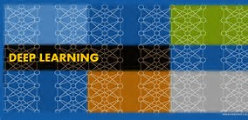
DL (Deep Learning) Workspace
Turn-Key Cluster for DL Training, Exploration, Inferencing, etc..
Hongzhi Li, Jin Li, Sanjeev Mehrotra

Slide 2
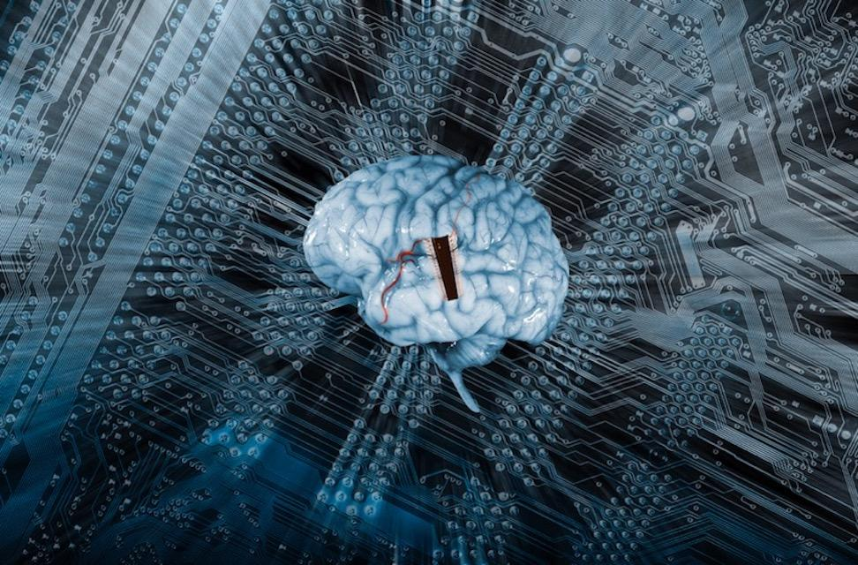
AI is moving from lab to production
Notes:
Artificial Intelligence (AI) is moving towards becoming a core component of modern applications. In the coming years, almost every application that we use will depend on somes form of AI. We are seeing amazing speed of AI technology transfer from lab to real world production. Freshly published result of computer vision, speech recognition and machine translation systems are being quickly turned into practice and deployed in production system.

Slide 3
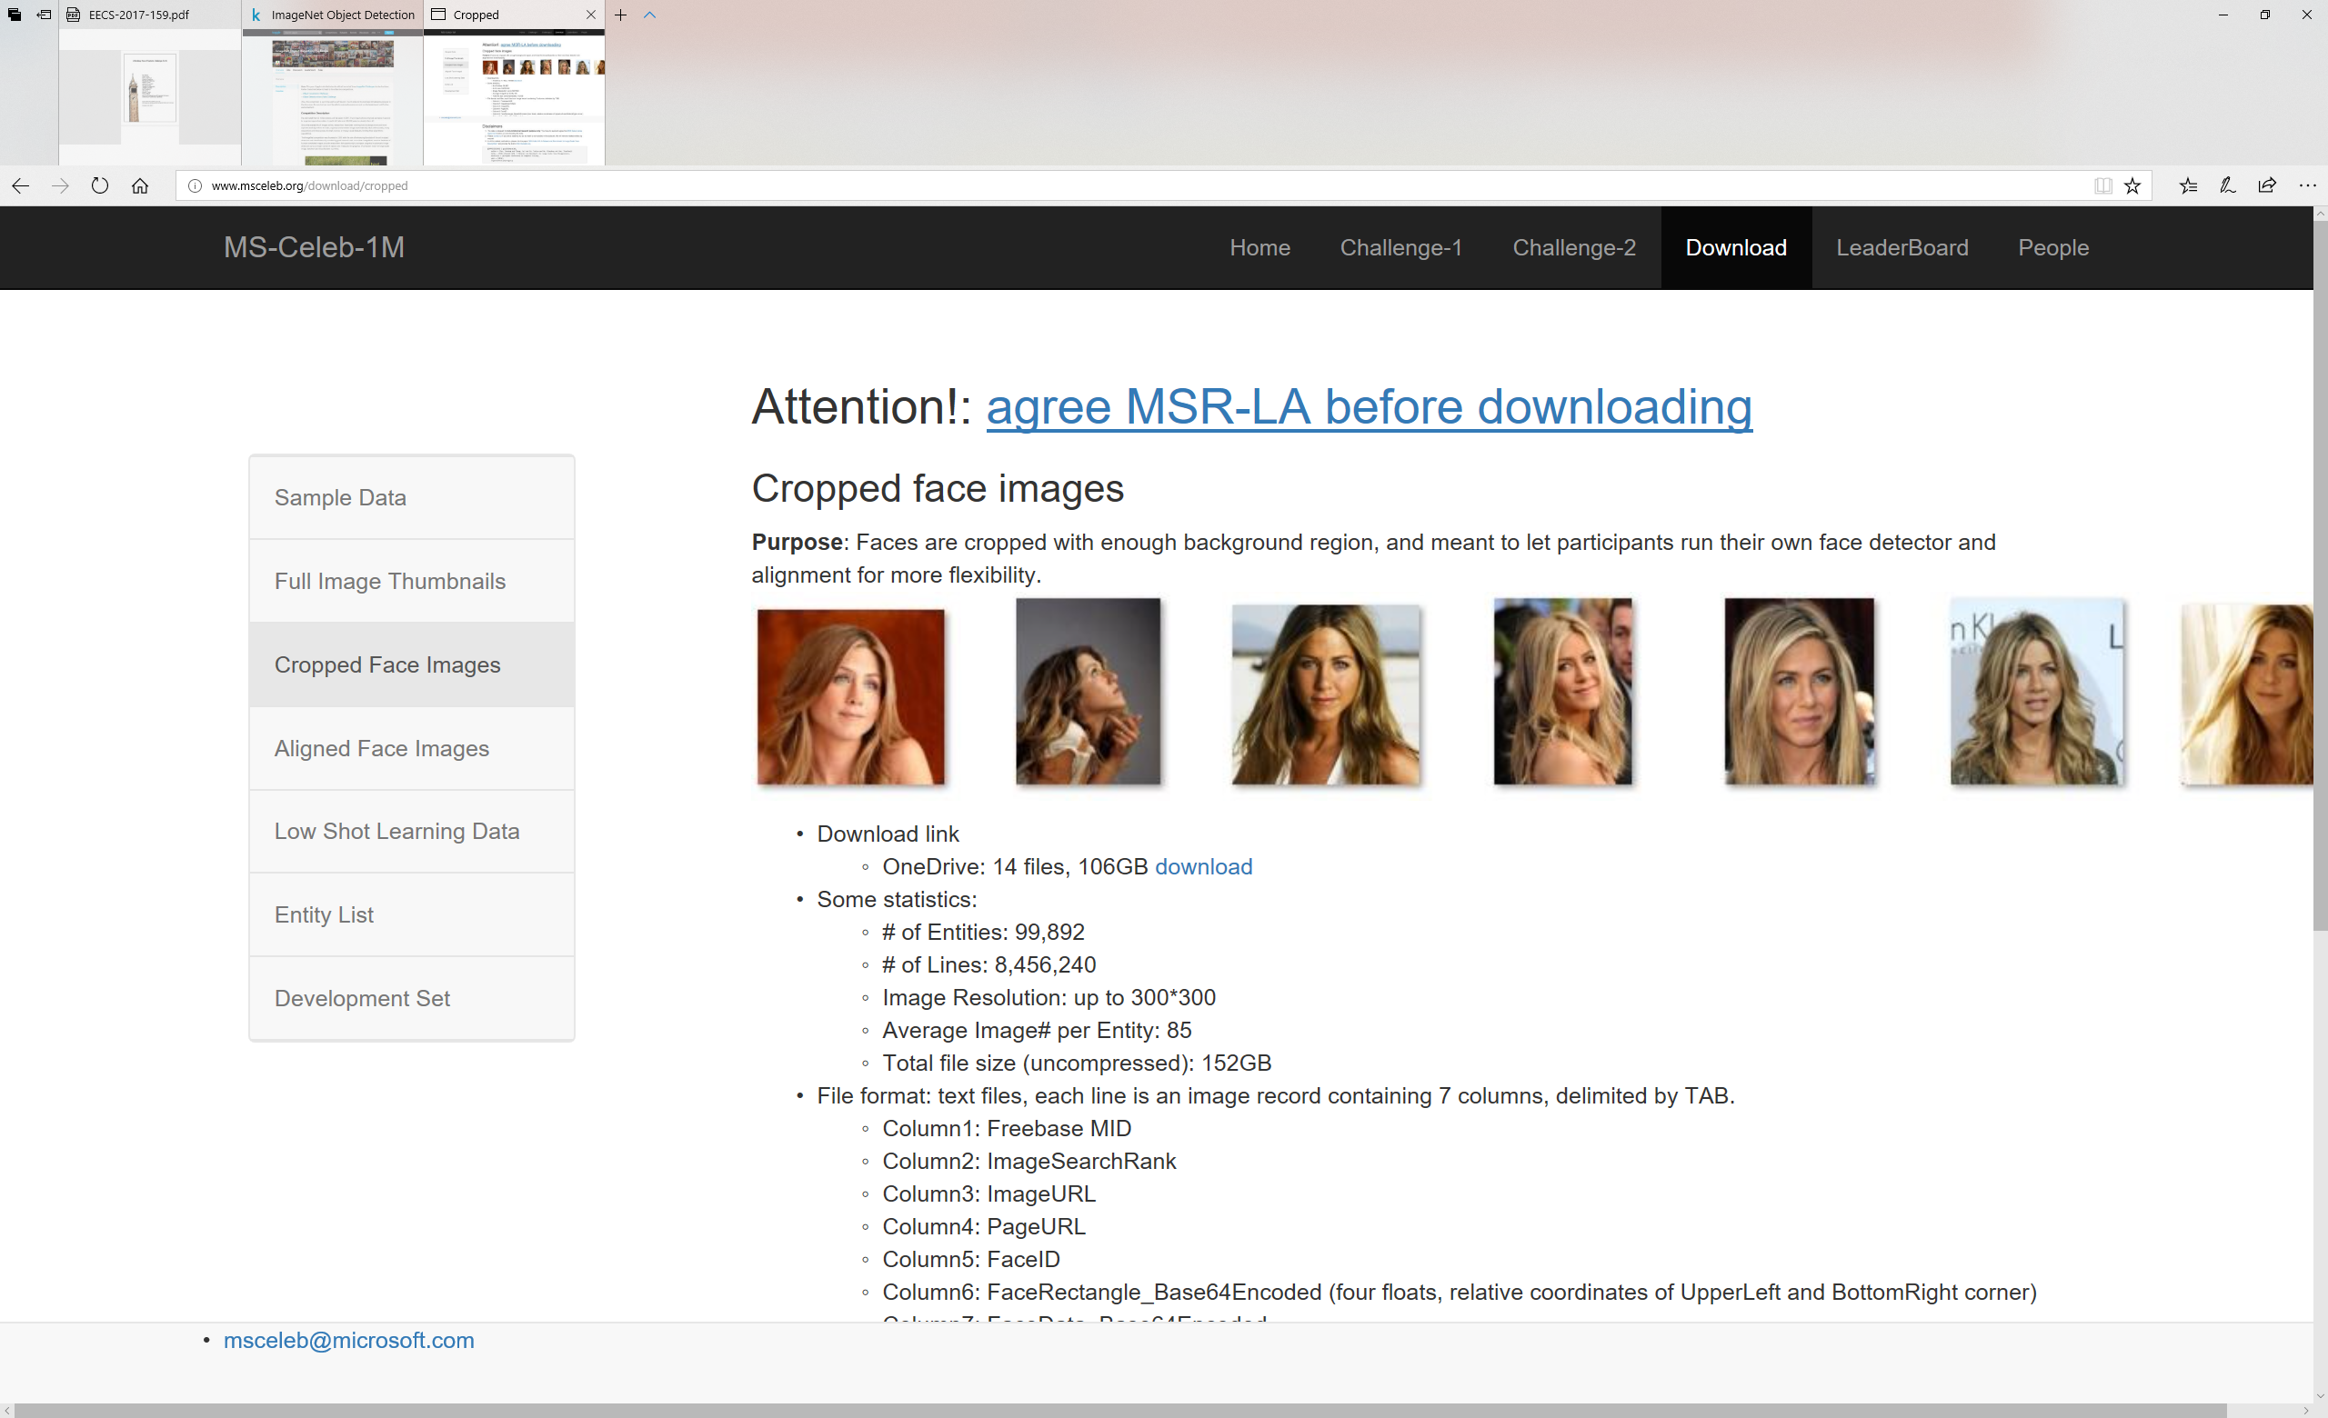
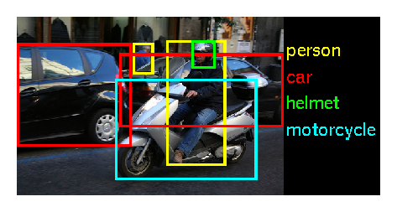
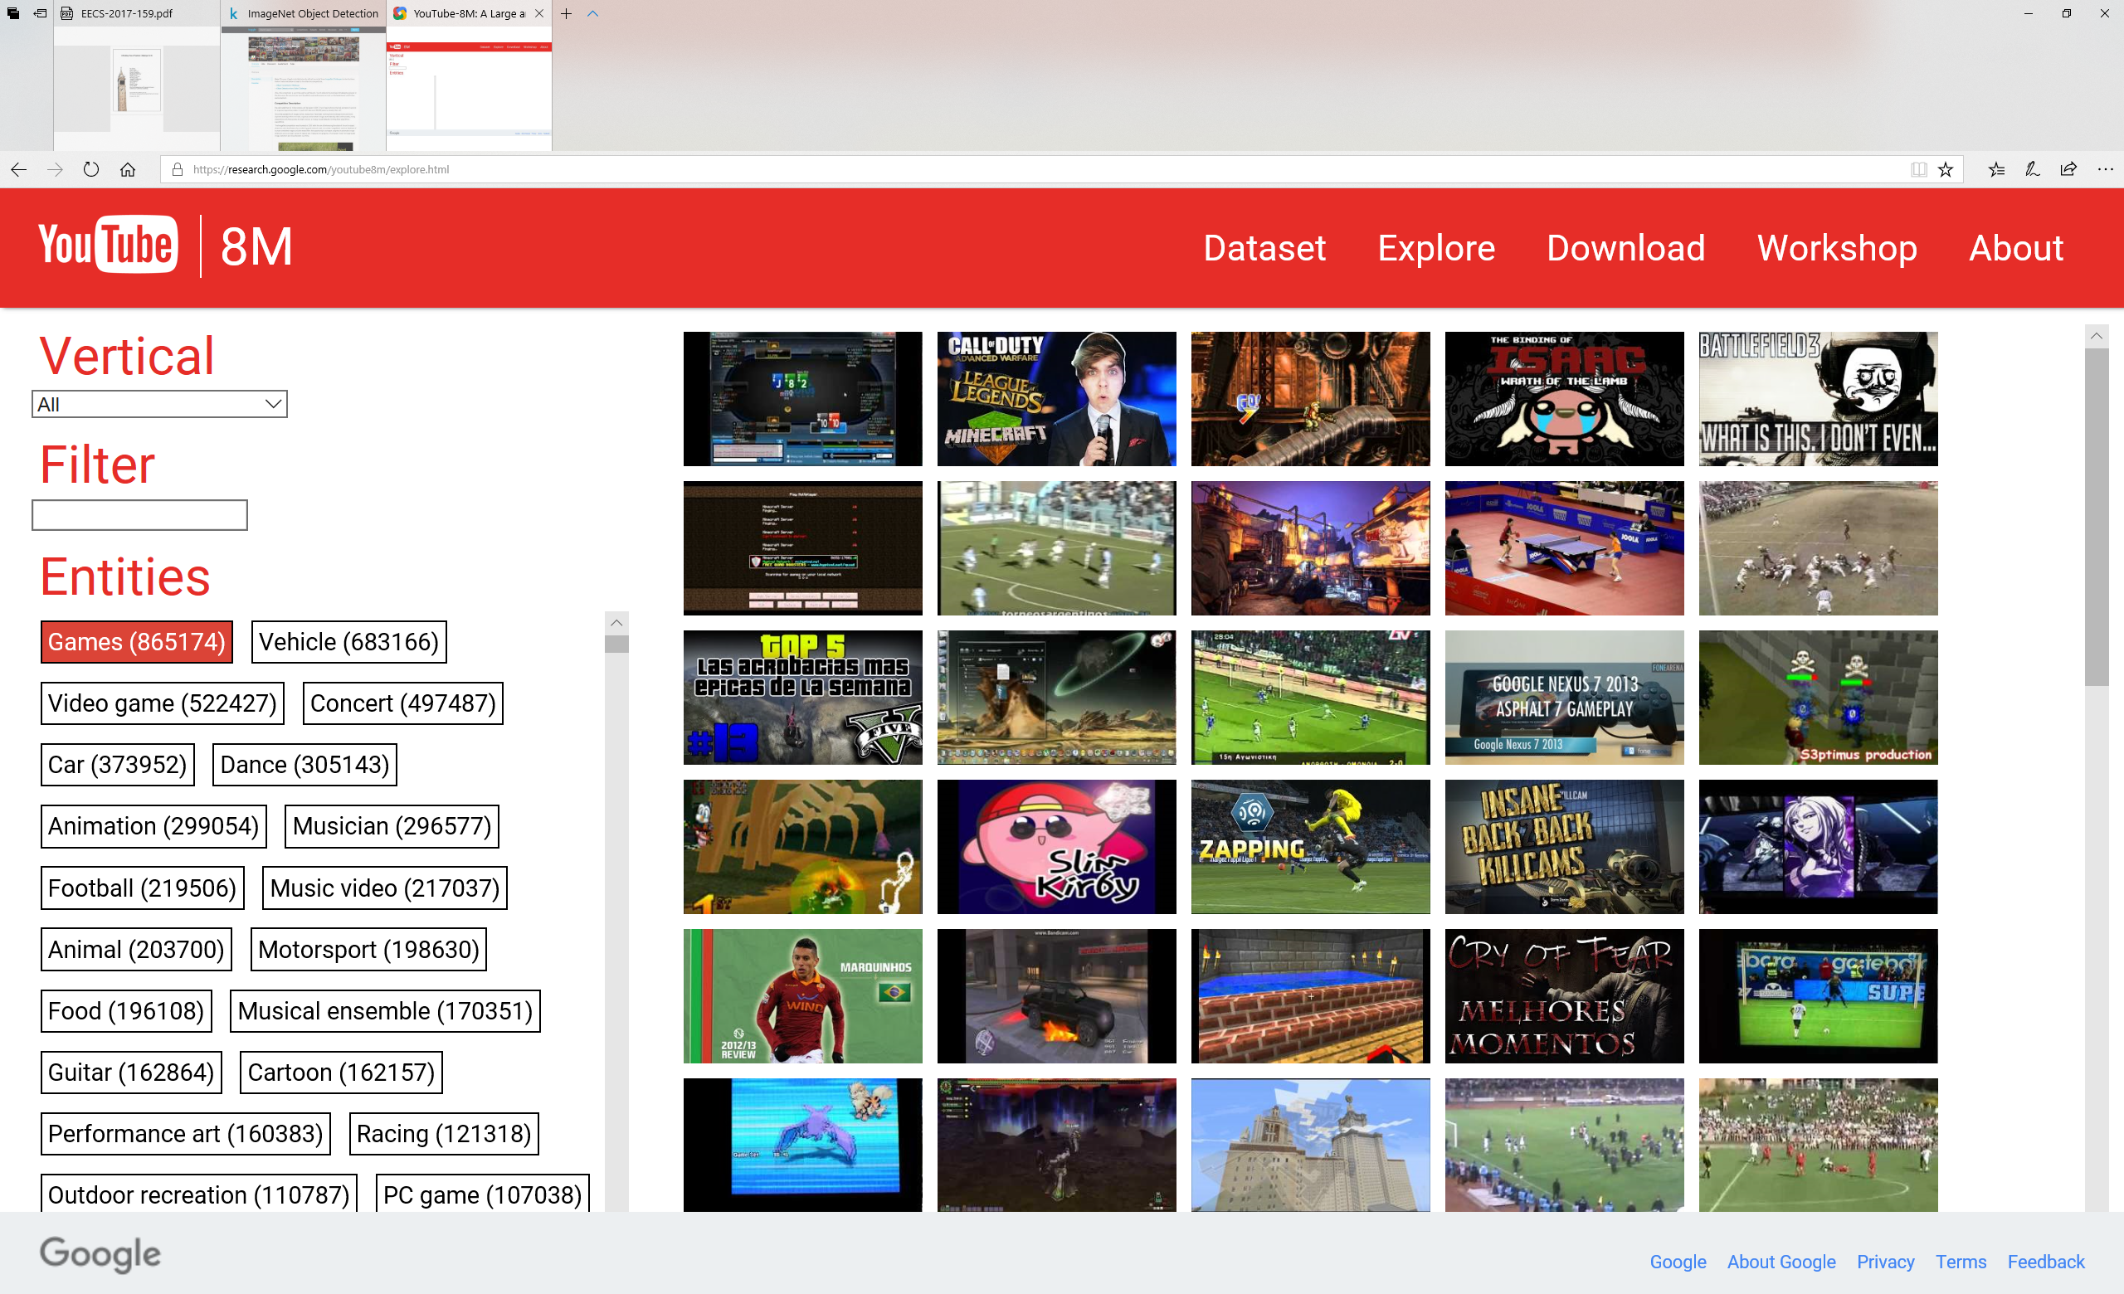
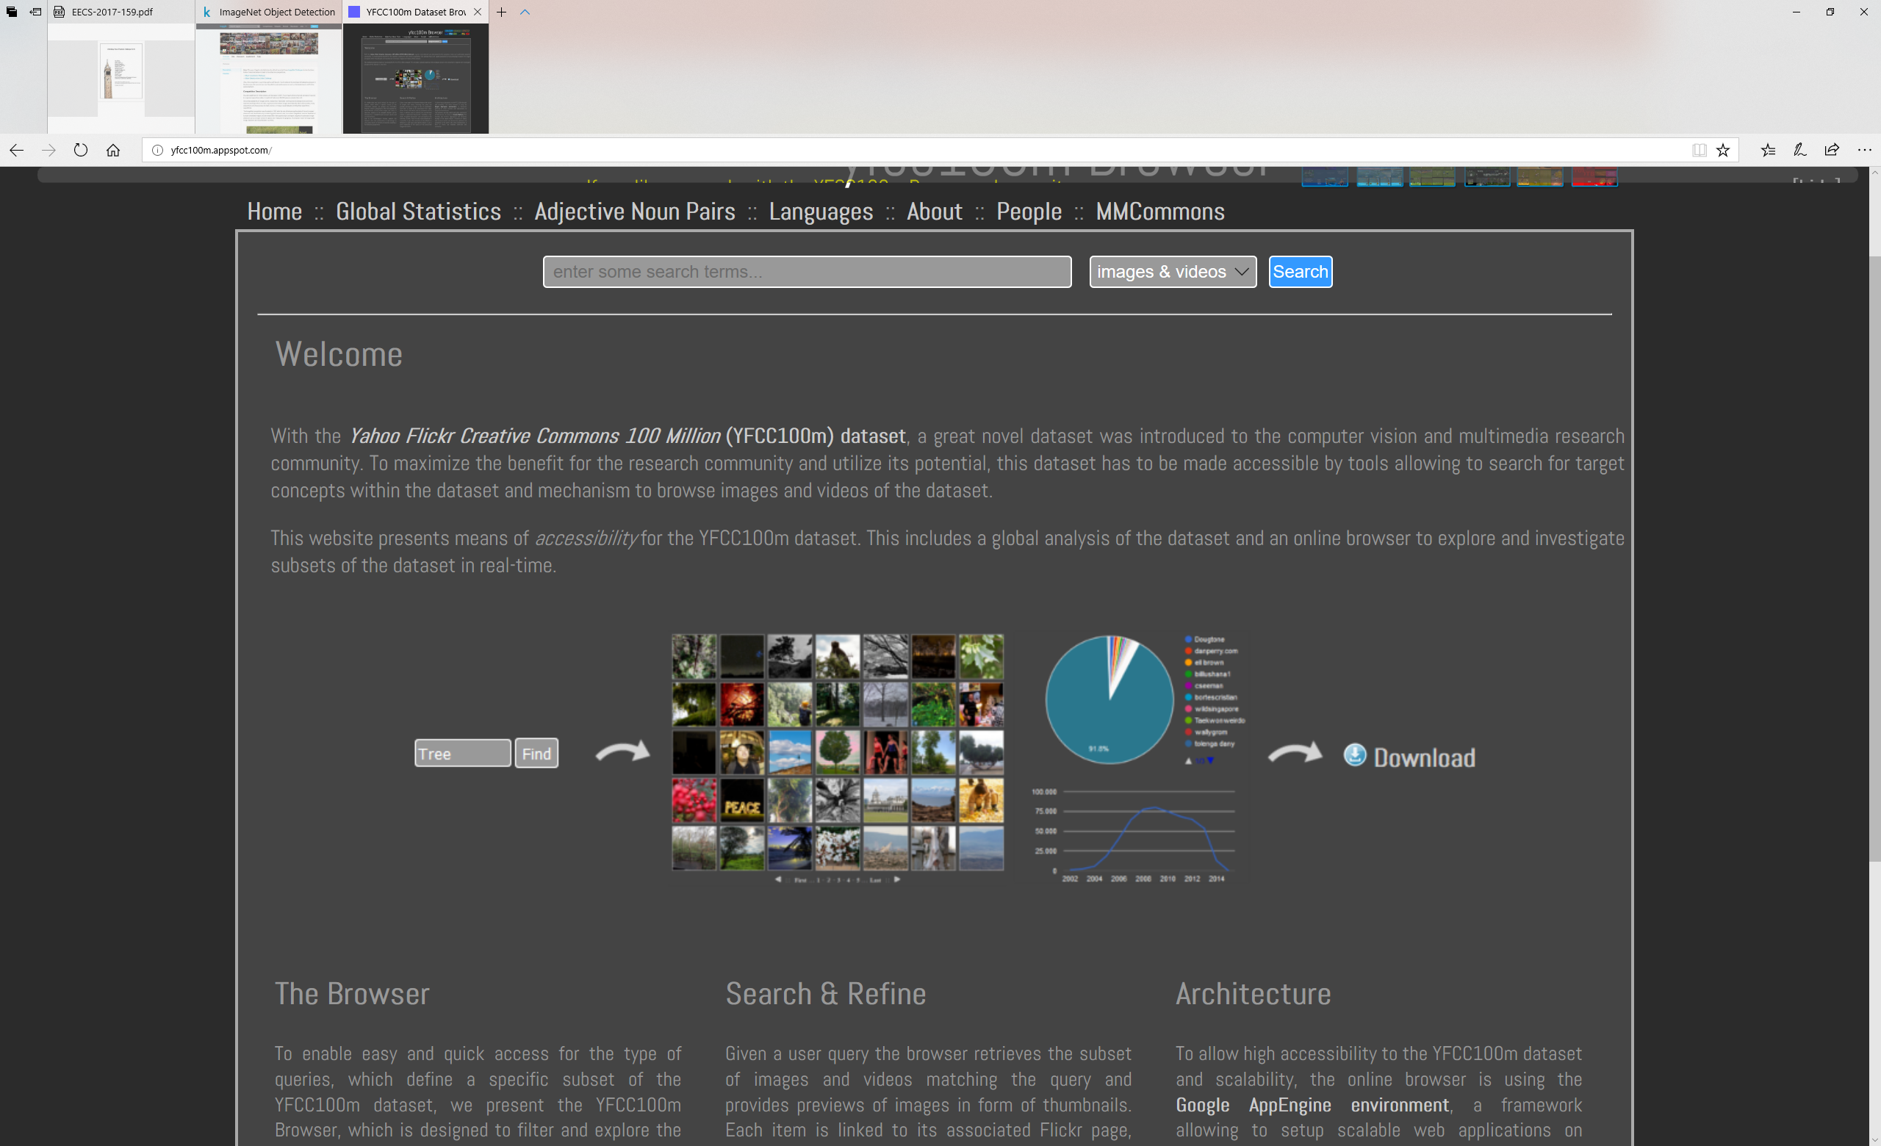
Big Data
Celebrity 1M
Image Net
YFCC 100m data set
Youtube 8M
Notes:
These changes have been made possible by a number of driving force. The first driving force is unprecedented levels of data availability, and distributed system that is capable of computing upon the data. E.g., this graph shows the availability of some of the publicly available image/video dataset. (ImageNet, Celebrity 1M, YFCC 100m data set, Youtube 8M).

Slide 4
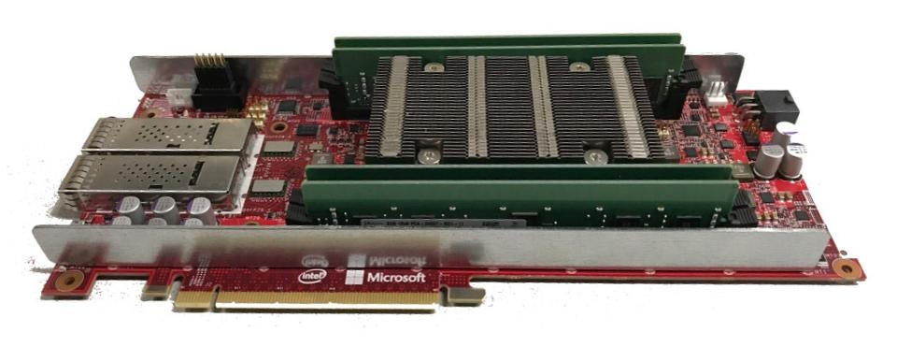
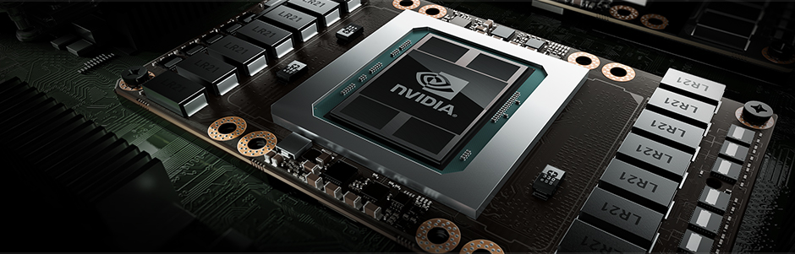
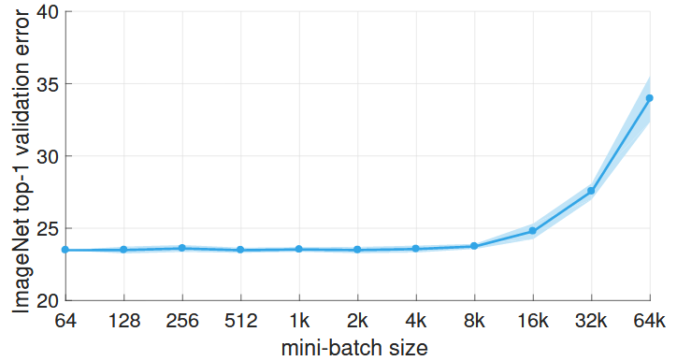
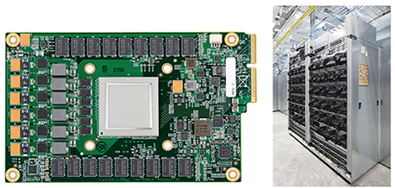
Big Computation
Microsoft Brainwave mezzanine card
( using Intel Altera Stratix 10 FPGA)
Nvidia P100 GPU
Facebook used the open source deep learning framework Caffe2 and their Big Basin GPU server that has eight NVIDIA Tesla P100 GPU accelerators that are interconnected using NVIDIA NVLink.
Google TPU
Notes:
A second driving force of change in the AI landscape is the rapid increasing big compute resource. This slide shows some.
Example, Nvidia just releases P100 GPU. It is capable of performing 9.3 TeraFlops float, 18.7 TeraFlops F16.
Google TPU: 225,000 predictions a second vs 13194 predictions a second. 30-80x performance per watt. (28nm process, runs at 700 Mhz and consumes 40W when running). Package the processor as an external accelerator card and fit into an SATA hard disk slot. Connect to host via PCIe Gen3 x16 bus that provides 12.5GB/s. TPU has 65536 8-bit integer multiplier. (vs a few thousands 32-bit floating point multiplier. ) [ 92 Tops per second, 65536x700Mhz]
Microsoft Brainwave: 39.5 Teraflops (130,000 compute operation per cycle).

Slide 5
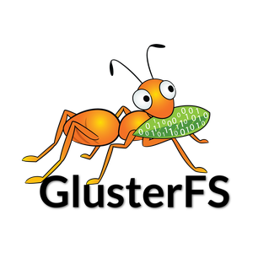
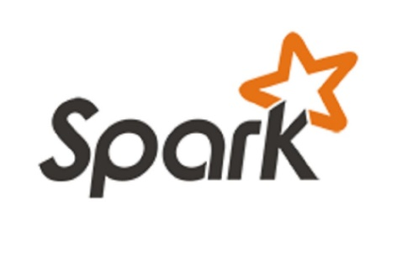
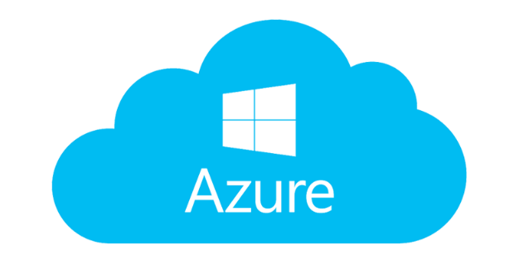




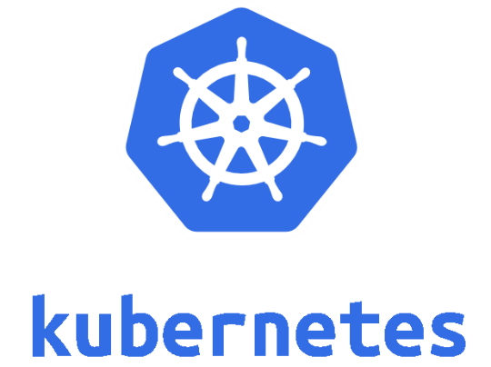



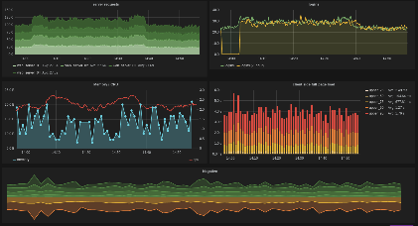




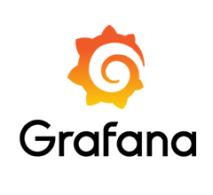
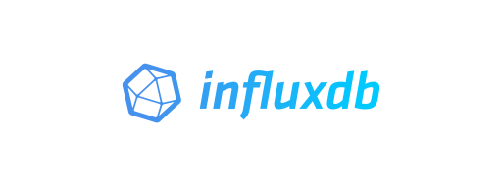

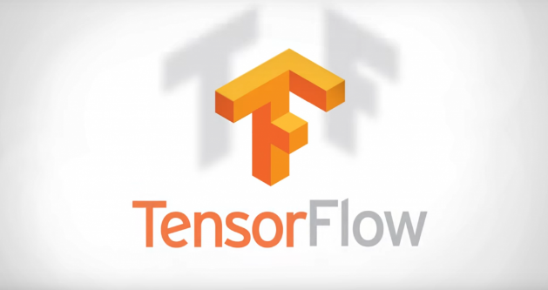
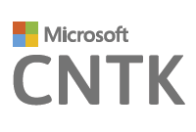



Big System & Open Source access of Technology
Notes:
A third driving force that enables rapid AI adoption is the accessibility of big data compute platforms and deep neural network training platform. This slide shows icons of the system platform that we have used in the DL Workspace project. We note that all of the components included on the slide is released in open source.

Slide 6

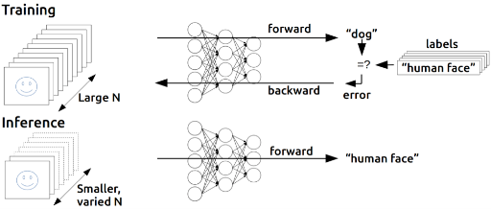
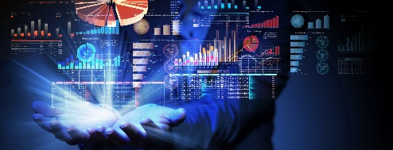
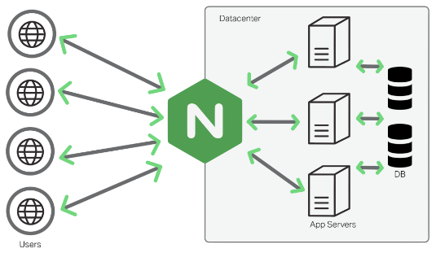
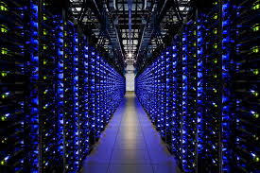
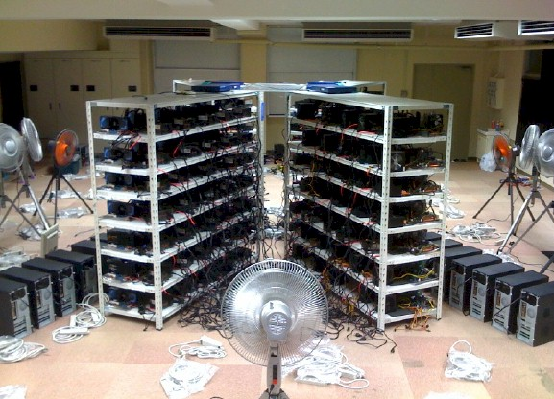
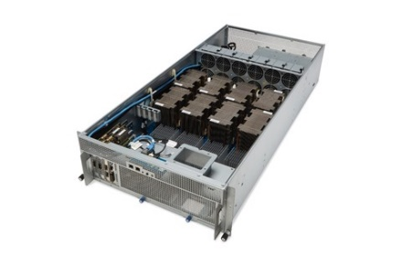
DL Workspace: Turnkey Shared AI Computing Cluster
Interactive Exploration
Training
Data Analytics
WebUI/Restful API
Serving
DL Workspace
DL Workspace
DL Workspace
Group
Server
Individual
machine
Shared
Cluster
Notes:
Upon this open source ecosystem, we have built DL Workspace, a turn-key Cloud computing infrastructure for AI scientists. With DL Workspace, AI scientists can share a cluster, which can be an individual machine, a group of servers, or a shared cluster in cloud. They can manage AI training, interactive exploration, inference, and analytics on the cluster without any installation. DL Workspace speed up workflows of AI scientists, and can significantly speed up the process of turning AI from lab to production.

Slide 7


Slide 8
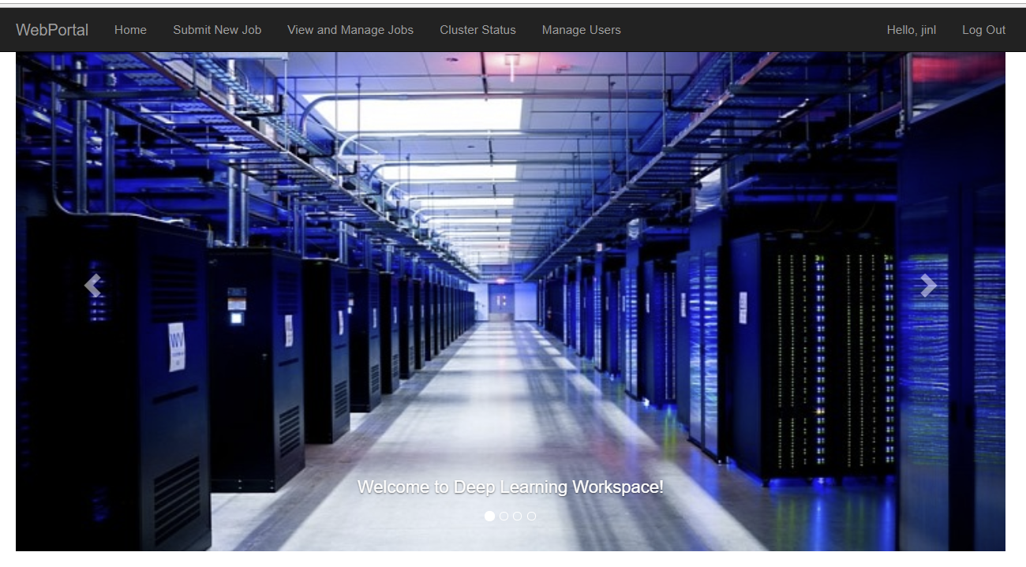
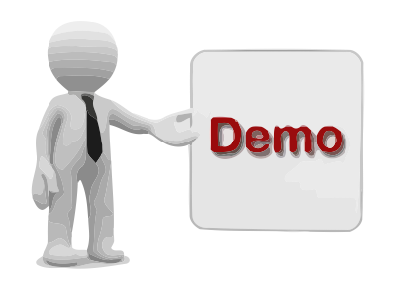

Slide 9
Building DL Workspace

Slide 10
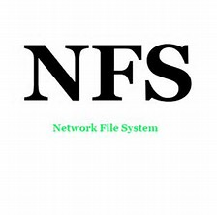

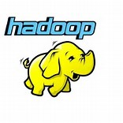
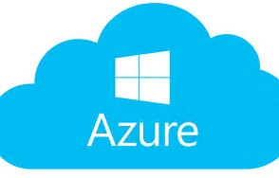
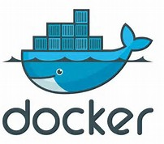
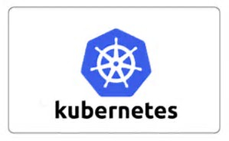
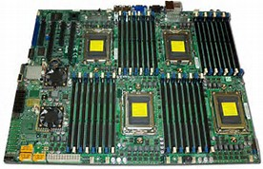
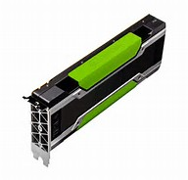

DL Workspace: Architecture (Modularly built)
Interactive
Workload
Training
Data Analytics
Inferencing/Serving
Filesystem
Plug-in
Container
Orchestration
+
Pluggable
Device Driver
Nvidia GPU/Infiniband (FPGA, other GPU, etc..)
Base OS
or
Hardware
CPU
GPU
Notes:
We built DL Workspace modularly, as shown in the slide.
We can deploy to either physical machine, or VM in cloud. The system supports both CPU and GPU. (but it can be extended to other hardware). [ Each additional hardware need appropriate investment ].
DL Workspace can run on either CoreOS or Ubuntu. We use docker to containerize workload, and use kubernetes to orchestrate cluster.
DL workspace uses shared storage in the form of NFS, GlusterFS, Hadoop / Azure file share.
On top, you can run workload as pod.

Slide 11
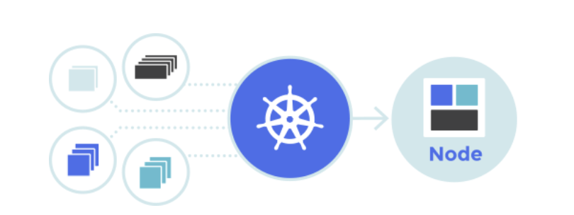
Kubernetes
An open-source system for automating deployment, scaling, and management of containerized applications.
De-facto standard for container orchestration on a cluster as seen by the rapid adoption by almost all big and small companies
Notes:
DL Workspace leverages Kubernetes, which is an open-source system for automating deployment, scaling and management of containerized applications.
Kubernetes is considered the future (de-facto standard) for container orchestration on a cluster. It is being rapidly adopted by almost all big/small companies.

Slide 12
Kubernetes
Simple architecture – each node runs a single binary (kubelet) as a service
Kubelet advertises resources to API server
Kubelet maintains and launches containers using Docker engine API
Clients talk to cluster via API server which itself runs as a pod
Scheduler runs as another pod
Node 1
Node 2
Node 3
Node 4
Pod
Pod
Pod
Pod
Pod
API Server
Pod
Pod
Pod
Scheduler
Master Node
Worker Nodes
Notes:
Kubernetes evolves from Borg, Google’s internal deployment tool with a role similar to Autopilot. Its initial design purpose is to orchestrate microservice as containers in a cloud deployment environment.
A Kubernetes cluster consists of (1, 3, 5) master nodes and any number of additional Kubernete nodes[largest cluster scales to thousands of nodes]. The master is responsible for maintaining the desired state of your cluster. On the master nodes, there are etcd (which is driven by a RAFT backed consensus protocol a globally available configuration store), kube-api service and. [
Optionally, dashboard: for monitoring. UI version of Kubectl.
Heapster: cluster monitoring.
Kube-controller-manager: The Kubernetes controller manager is a daemon that embeds the core control loops shipped with Kubernetes.
kube-scheduler: assign binding to pod spec.
]
Each Kubernete node runs a single binary (kubelet) as some other services [ pods on node:
Kube-proxy: kubernete network
Weave-net/freeflow
]. Kubelet advertises resources to API server (another pod).
API server is the main management point of the cluster. API servers also accepts request by user (e.g., pod creation, termination), records the information in etcd. The scheduler monitor the information in etcd, which is picked up and exected by scheduler.

Slide 13
Extending device support (KubeGPU)
Worker Nodes
Advertise Extended Resources
Device Plugin or custom Container Runtime Interface (CRI)
Node 2
Pod
Node 1
Pod
Device
Allocation or custom Container Creation
Pod Placement
Resource Advertisement
CPU, memory
Pod
API Server
Node 3
Pod
Pod Creation
Custom Resources
GPU – including GPU type, memory, speed, topology
Infiniband information
FPGA
Flash Compute
Pod
Scheduler
Master Node
Node 4
Pod
Pod
Pod
Notes:
When Kubernetes is initially released, the main resource to be orchestrated is CPU and memory. It is mainly designed for generic computation task in on-prem and in-cloud environment. However, after its release, it is being significantly leverage upon for all kind of work load that is beyond its initial design. E.g., in AI workload, GPU resource is an critical resource. Moreover, GPU is highly asymmetrical, especially with related to its inter-GPU bandwidth. (draw a graph if needed). Another critical resource in AI workload is internode bandwidth, especially in the form of infiniband information. For a multi-node workload, it will be preferable to schedule pods on nodes that are close to each other.
Sanjeev is working on to extend and customize Kubernetes for AI workload.

Slide 14
What DLWorkspace Offer Beyonds Kubernetes
Turn-Key DL Experience
DL Toolkit setup and environment management
Integrated Web Portal (user/member management )
User/Job/Pod monitoring, usage policy (e.g., <4GPU per user with exception approved by admin, idle GPU pod > 2hrs will be terminated)
Cluster monitoring (GPU usage, Web portal monitoring, etc..)
API for launching deep learning workflow (e.g., hyper-parameter tuning)
Integration with big-data analytical environment (Hadoop/Yarn/Spark)
Integration with cluster file sharing (NFS/GlusterFS/Azure file share, etc..)
Notes:
One part of DLWorkspace:
Automated Kubernete deployment (from PXE server, etcd/VM setup, Kubernete deployment).
Kubernetes has its own API, however, directly expose kubernete API to user may have issues on 1) multi-tenancy, 2) Kubernetes scheduling limitation, 3) Kubernete dashboard/api limitation (

Slide 15
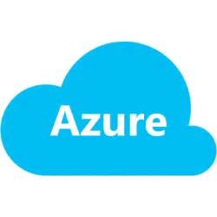
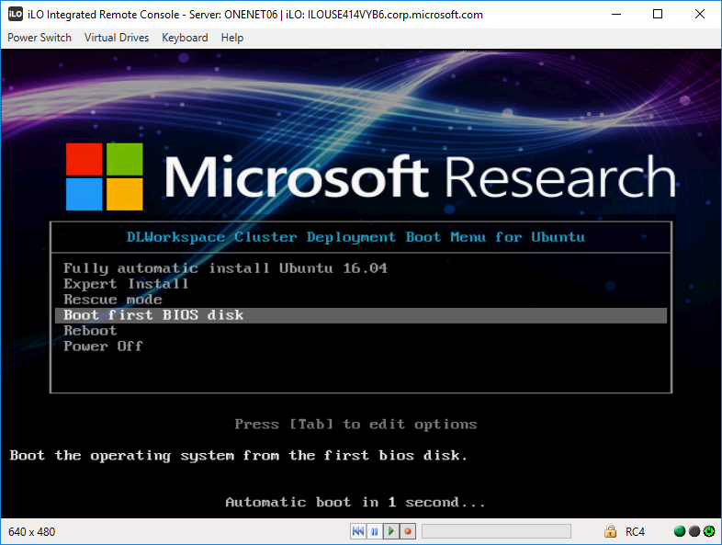
Deployment: On-Prem or Cloud
Notes:
We have shown deployment in Azure. We have deployed PXE servers for both CoreOS and Ubuntu that can push DL Workspace to a large cluster of private servers.

Slide 16
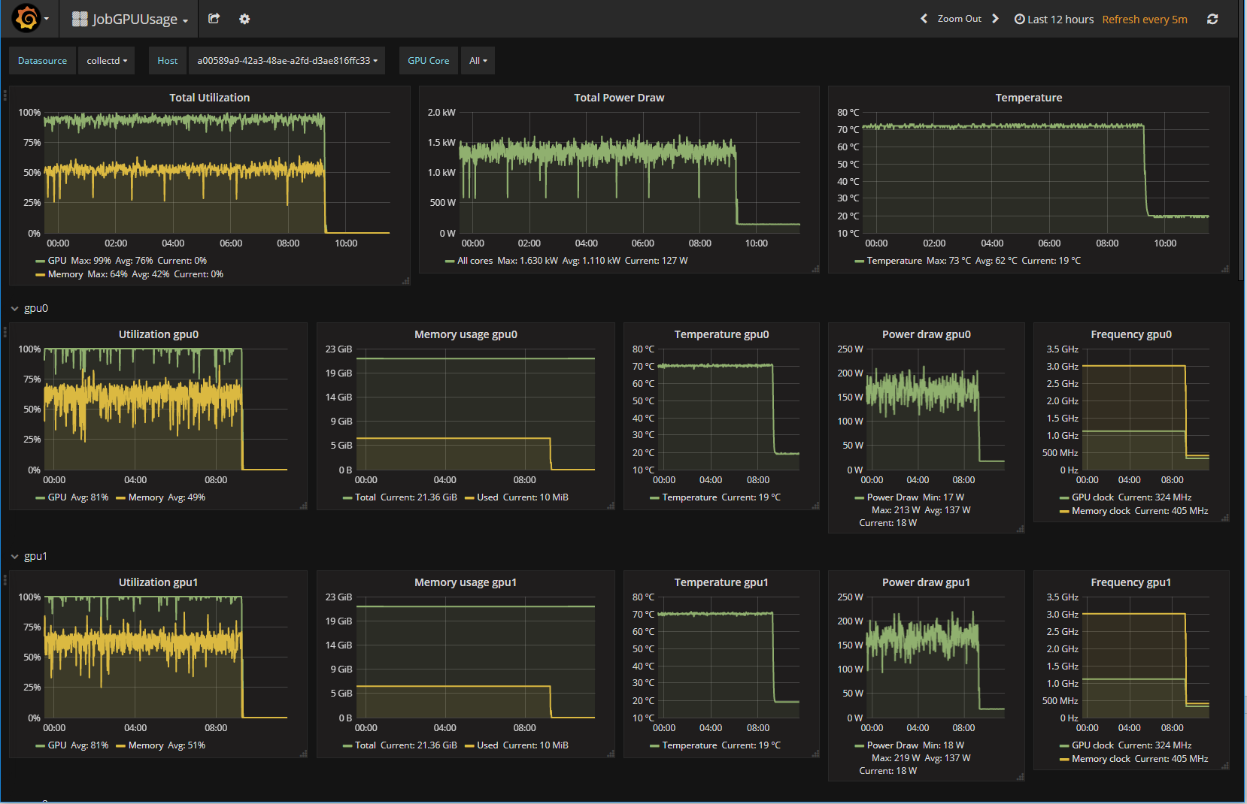
Monitoring

Slide 17
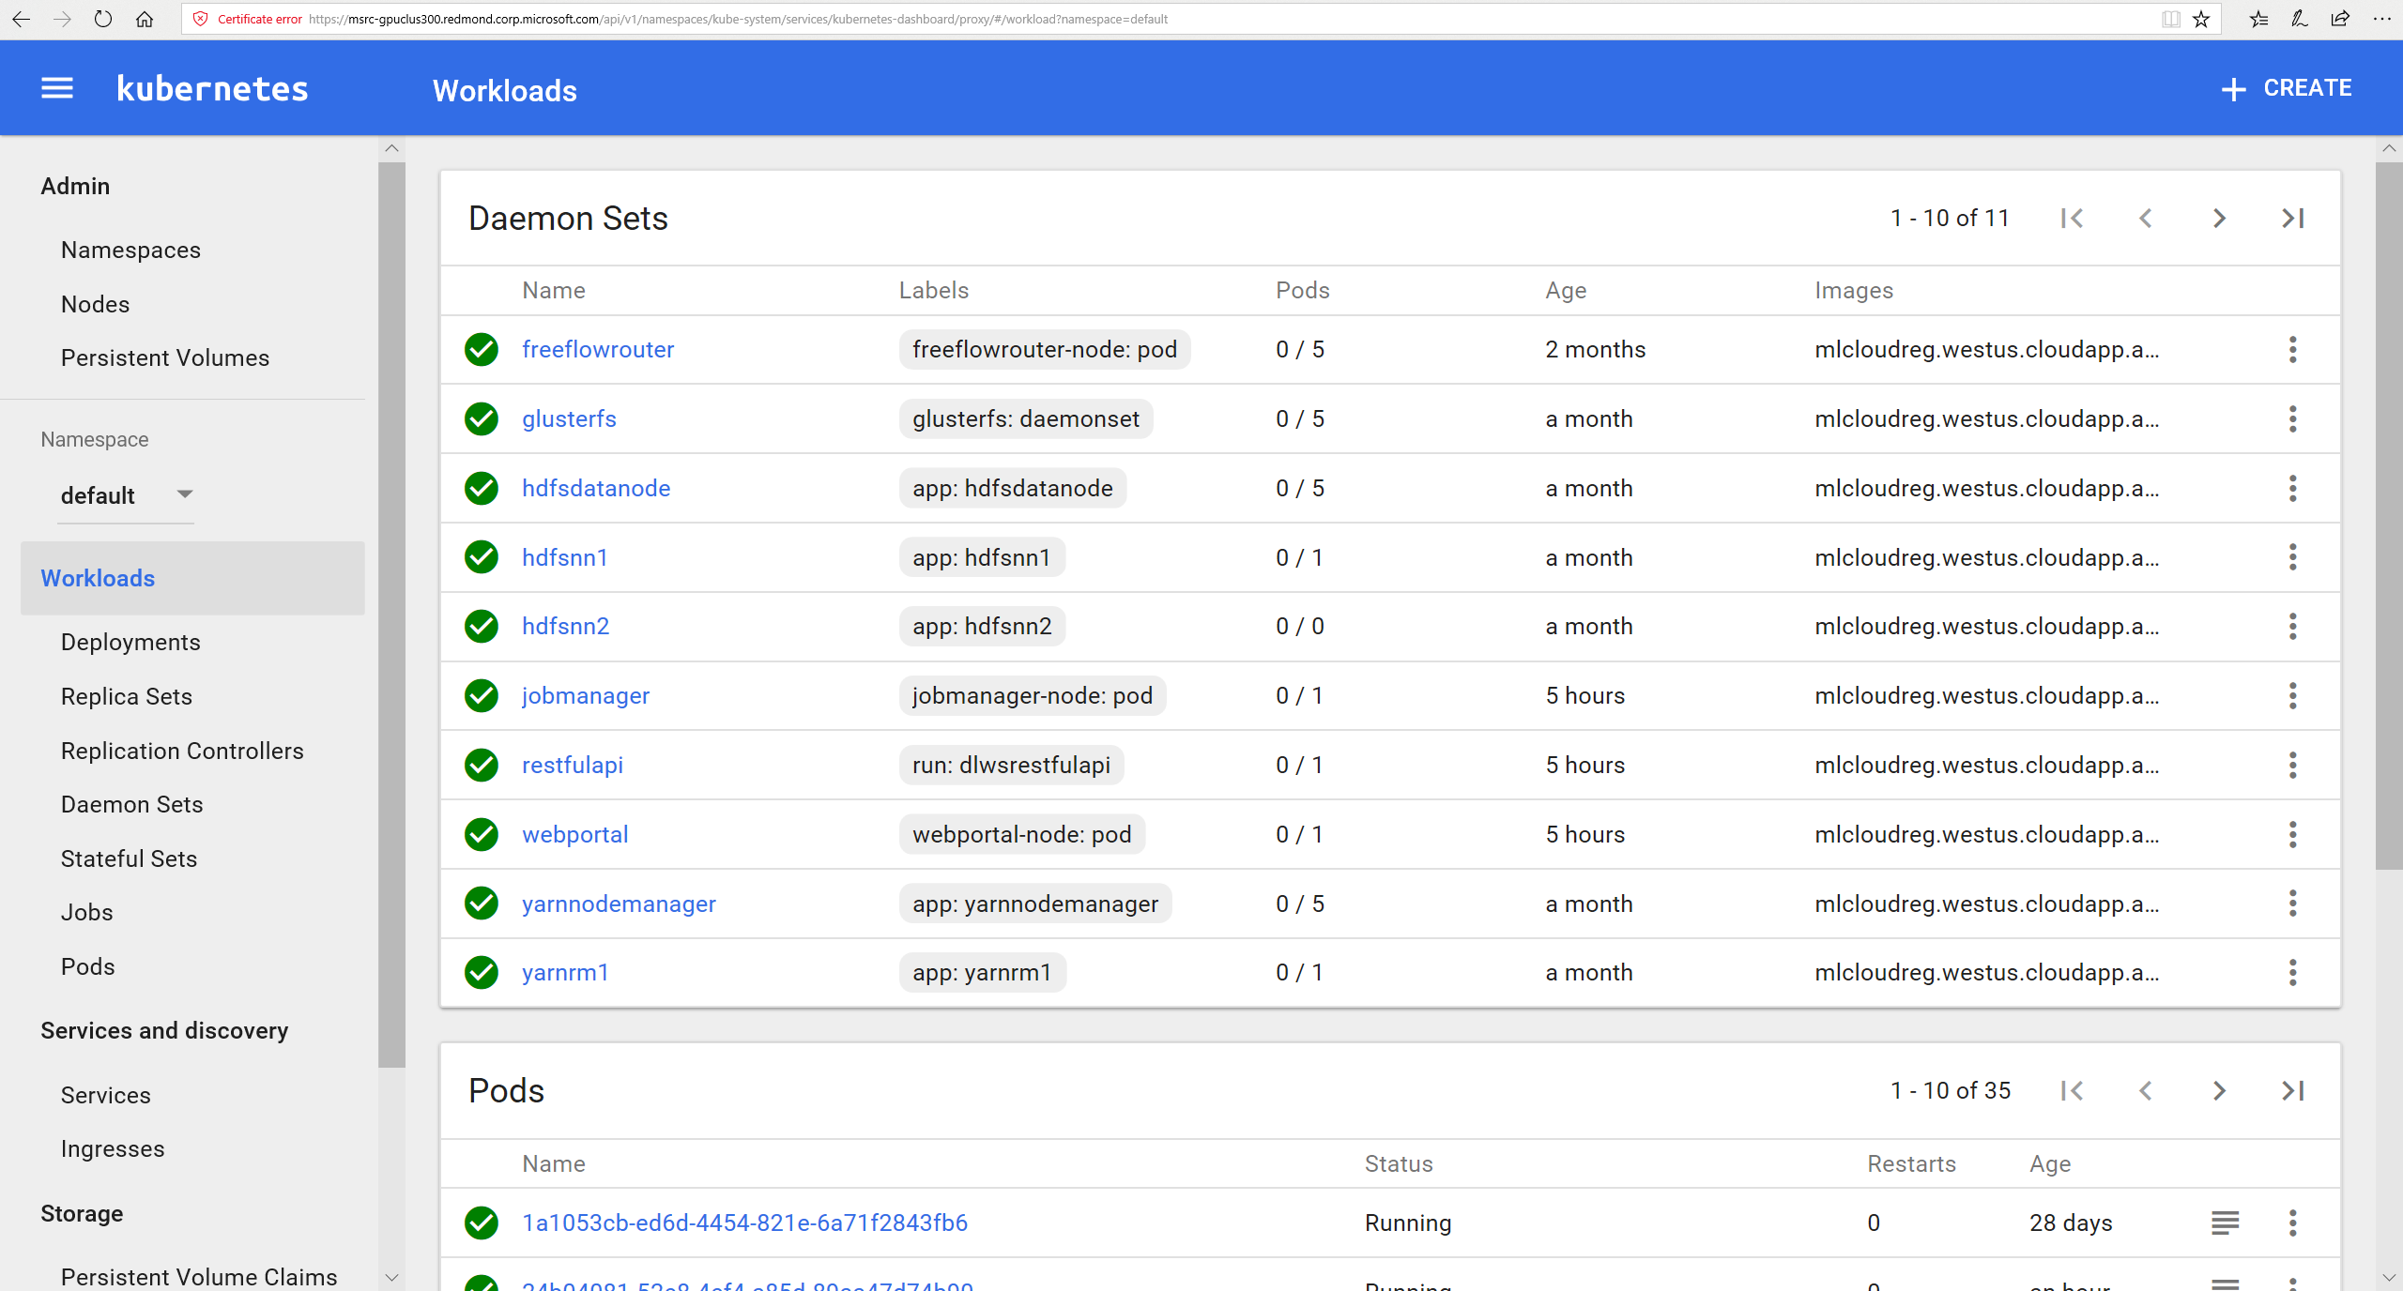

Slide 18
DL workspace: Summary
A Turn-key open source cluster environment for AI scientist
No-installation required
Support Nvidia GPU/CPU
Support popular DL toolkit: Caffe, CNTK, TensorFlow, MxNet, etc..
Support single machine and/or multi machine training
Scenario
Dev box (interactive exploration) for the group members
Follow/repeat/extend DL experiments (ToDo)
DL training
Data analytics
Inferencing/serving
Also support:
HDFS/spark
Kubernetes cluster
With fully integrated cluster monitoring

Slide 19
Backup

Slide 20
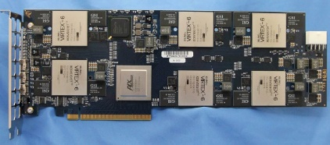
DL Workspace: Architecture (Modularly built)
Interactive
Workload
Training
Data Analytics
Inferencing/Serving
Filesystem
Plug-in
Container
Orchestration
+
Pluggable
Device Driver
Nvidia GPU/Infiniband (FPGA, other GPU, etc..)
Base OS
or
Hardware
CPU
FPGA
GPU

Slide 21
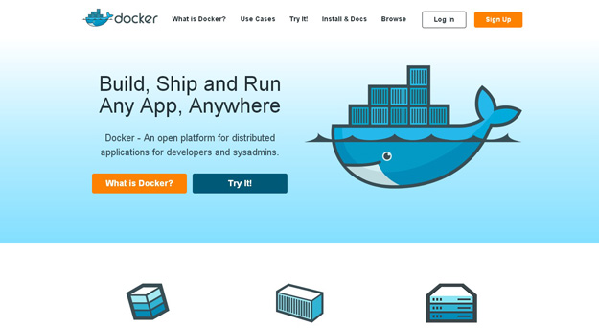

Docker: Containerized Microservice
Why docker
Run anywhere (laptop, desktop, Azure, etc..)
Streamline development & testing
Lightweight (only the necessary processor in docker)
Match well with Microservices Architecture
Alternative:

Slide 22
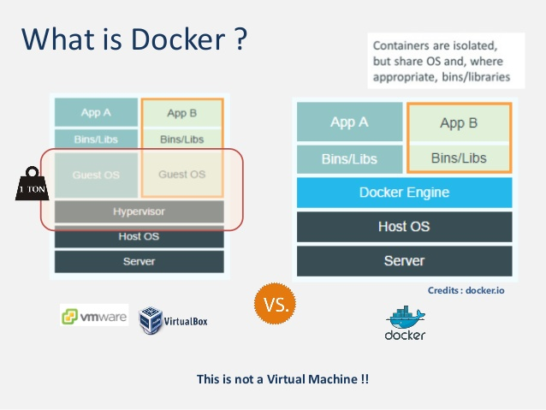

Slide 23
Why Docker in DL workspace
It contains everything you need to quickly start
E.g., tensorflow docker contains:
All binaries package used by tensorflow (e.g., curl, libpng, libzmq, zip, etc..)
Python (with pip, jypyer, numpy, scipy, sklean, etc..)
[ Optional, for –devel] Source code and build tools (bazel, etc..)
Proper cuda libraries
Different DL toolkit (of different version) may use different and conflict libraries (e.g., cudnn? Version)
Docker nicely encapsulate everything needed by a workload (avoid dll hell)

Slide 24
How to use docker in DL Workspace:
Public docker [quickest route]:
Most major DL toolkit today (e.g., TensorFlow, CNTK, Caffe, MxNet) has publicly released docker that is directly useable in DL workspace
Customized docker (e.g., TensorFlow with XLA support)
Most major DL toolkit today (e.g., TensorFlow, CNTK, Caffe, MxNet) has released source Dockerfile to build their docker
You can start with them, and to customize the build (e.g., to try out new/customized feature)

Slide 25
Kubernetes
Kubernetes is an open-source system for automating deployment, scaling, and management of containerized applications.
Kubernetes places a group of containers (a pod) onto a node in the cluster
Kubernetes is the future (de-facto standard) for container orchestration on a cluster as seen by the rapid adoption by almost all big and small companies

Slide 26
Kubernetes
Simple architecture – each node runs a single binary (kubelet) as a service
Kubelet advertises resources to API server
Kubelet maintains and launches containers using Docker engine API
Clients talk to cluster via API server which itself runs as a pod
Scheduler runs as another pod
Node 1
Node 2
Node 3
Node 4
Pod
Pod
Pod
Pod
Pod
API Server
Pod
Pod
Pod
Scheduler
Master Node
Worker Nodes

Slide 27
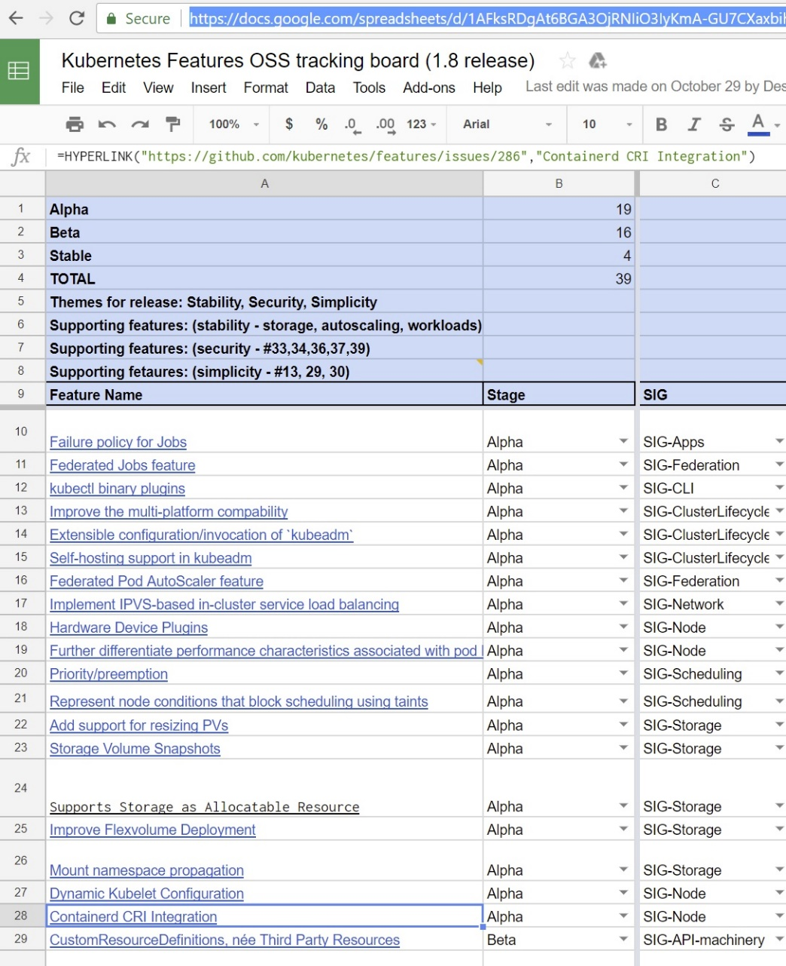
Kubernetes Open Source Priorities
Initially meant for microservices and workloads which did not too much performance
Recent work on Kubernetes has focused on
Improving performance
Richer control over pods
Improved device support
Extensibility
Key Features ongoing and in 1.8 Release
Extensibility – binary plugins, device plugins, custom resource definitions

Slide 28
Extending device support
Worker Nodes
In Kubernetes core only following resources are natively supported for container resource requests
CPU
Memory
Alpha support for number of GPUs – no syntax to specify type, memory, GPU topology
Node 2
Pod
Node 1
Pod
Resource Advertisement
CPU, memory
Pod Placement
Pod
API Server
Node 3
Pod
Pod Creation
Pod
Scheduler
Master Node
Node 4
Pod
Pod
Pod

Slide 29
Extending device support
Worker Nodes
Advertise Extended Resources
Device Plugin or custom Container Runtime Interface (CRI)
Node 2
Pod
Node 1
Pod
Device
Allocation or custom Container Creation
Pod Placement
Resource Advertisement
CPU, memory
Pod
API Server
Node 3
Pod
Pod Creation
Custom Resources
GPU – including GPU type, memory, speed, topology
Infiniband information
FPGA
Flash Compute
Pod
Scheduler
Master Node
Node 4
Pod
Pod
Pod

Slide 30
Extending Scheduler / Resource Allocation
Kubernetes default scheduler itself is a pod which gets pods specs from API server and specifies pod placement by writing this information back to API server
Can easily be replaced with custom scheduler
Kubernetes also provides scheduler extender to extend scheduler functionality
Can look at various topics for research
Coordinated pod allocation (e.g. for distributed workloads running multiple pods)
Pod pre-emption and priority
Along with custom CRI, can also do pod suspension and container snapshot
Node 1
Pod Placement
Pod
API Server
Pod
Scheduler
Master Node

Slide 31
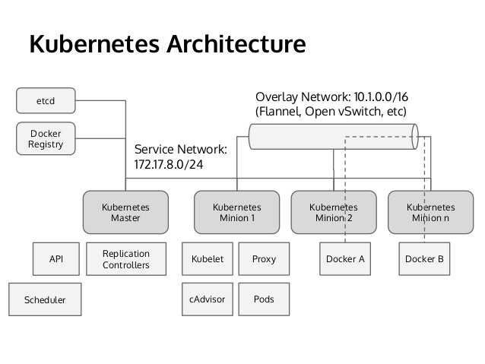
Kubernetes: Cluster Scheduling & Orchestration
Why
Top projects on github
Significant Slack and Stack Overflow community
[From our own experience] pretty stable platform, good code base quality, extensive unit test/stress test in code
Alternative: CoreOS fleet, Swarm, DC/OS

Slide 32
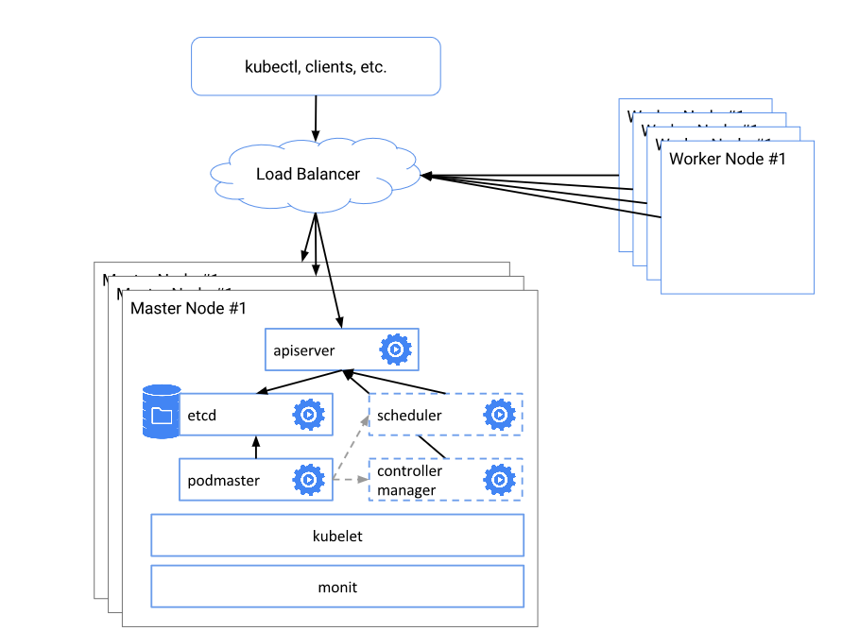
How Kubernetes Works?

Slide 33
What is a Kubernetes Pod?
A group of one or more containers and shared storage
E.g., a distributed training pod can contain:
A parameter server
Multiple workers

Slide 34
GPU aware kubernetes resource scheduling
Terminology:
Allocatable – what is available at node
Used – what is already being used from node (called RequestedResource)
Requests– what is requested by container(s) for the pod
Kubelets send “Allocatable” resources for nodes
Worker 1
Scheduler – Keeps track of “Used”
Worker 2
Scheduling Request
Pod (Contianer) Spec
- Container Requests
Worker N

Slide 35
Example – GPU with NVLink
For 4 GPUs with two groups, each connected via NVLink to another
GpuGrp/0/Gpu/0/cards: 1
GpuGrp/0/Gpu/0/memory: 12GiB
GpuGrp/0/Gpu/1/cards: 1
GpuGrp/0/Gpu/1/memory: 12GiB
GpuGrp/1/Gpu/2/cards: 1
GpuGrp/1/Gpu/2/memory: 8GiB
GpuGrp/1/Gpu/3/cards: 1
GpuGrp/1/Gpu/3/memory: 8GiB
GpuGrp0
Gpu0
Gpu1
GpuGrp1
Gpu2
Gpu3

Slide 36
Group Allocation
Allocatable
Gpugrp1/0/Gpugrp0/0/gpu/dev0/cards: 1
Gpugrp1/0/Gpugrp0/0/gpu/dev1/cards: 1
Gpugrp1/0/Gpugrp0/1/gpu/dev2/cards: 1
Gpugrp1/0/Gpugrp0/1/gpu/dev3/cards: 1
Gpugrp1/1/Gpugrp0/2/gpu/dev4/cards: 1
Gpugrp1/1/Gpugrp0/2/gpu/dev5/cards: 1
Gpugrp1/1/Gpugrp0/3/gpu/dev6/cards: 1
Gpugrp1/1/Gpugrp0/3/gpu/dev7/cards: 1
Requests
Gpugrp1/R0/Gpugrp0/RA/gpu/gpu0/cards: 1
Gpugrp1/R0/Gpugrp0/RA/gpu/gpu1/cards: 1
Gpugrp1/R1/Gpugrp0/RA/gpu/gpu2/cards: 1
Gpugrp1/R1/Gpugrp0/RA/gpu/gpu3/cards: 1
Gpugrp1/R1/Gpugrp0/RB/gpu/gpu4/cards: 1
Gpugrp1/R1/Gpugrp0/RB/gpu/gpu5/cards: 1
Requests
Allocatable

Slide 37
Integration with community
Kubelets know nothing about GPUs
Resources to advertise
Eventual goal
Kubelets send “Allocatable” resources for nodes
Worker 1
Device Plugins (e.g. GPU)
Resources usage / docker params
Asks for fit
Scheduler – Keeps track of “Used”
Worker 2
Scheduler extender
Scheduling Request
Performs group allocation – writes update to pod spec with allocation
Pod (Contianer) Spec
- Container Requests
Worker N

Slide 38
System Diagram
SQL server
Cluster
Web Portal
RestfulAPI
Job Manager
K8s Master API

Slide 39
AI is moving from lab to production
Driven by broad availability of
Unprecedent level of data and computation
Methodological advances in machine learning
Innovations in system software and architectures
Unlock AI’s potential to improve life and society
Mission-critical AI
Personalized AI
Etc..
Notes:
With the increasing commoditization of computer vision, speech recognition and machine translation systems, AI is rapidly moving from research labs to production. These changes have been made possible by unprecedented levels of data and computation, by methodological advances in machine learning, by innovations in systems software and architectures, and by the broad accessibility of these technologies. Currently, what we observe of a common push by big technology companies is to use AI to improve life and society. This includes the use of AI for
Mission-Critical tasks: e.g., detecting fraud in banking, autonomous driving, robot-assisted surgery. And use AI for personalized task, e.g., figure out what I will be interested to buy.
(Challenge: design system to learn continually by interacting with a dynamic environment)
AI demand outpacing Moore’s law
Personalized AI:
Dennard scaling

